Slide 1
E6156 – Topics in SW Engineering: Cloud Computing
Lecture 2: Microservices, REST, PaaS, S3
© Donald F. Ferguson, 2021

Slide 2

Static Web Hosting
2 | E6156 – Topics in SW Engineering: Cloud Computing: Lecture 2 – REST, PaaS, S3 © Donald F. Ferguson, 2021

Slide 3
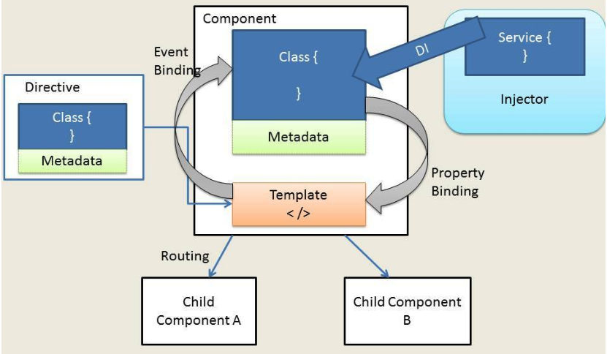
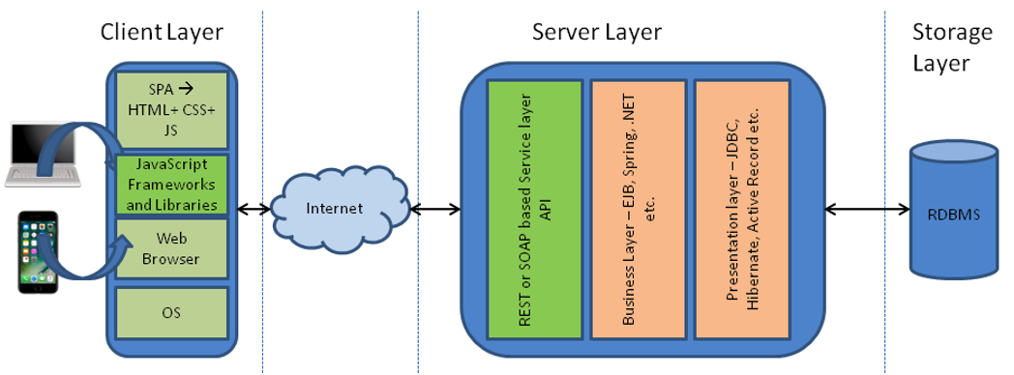
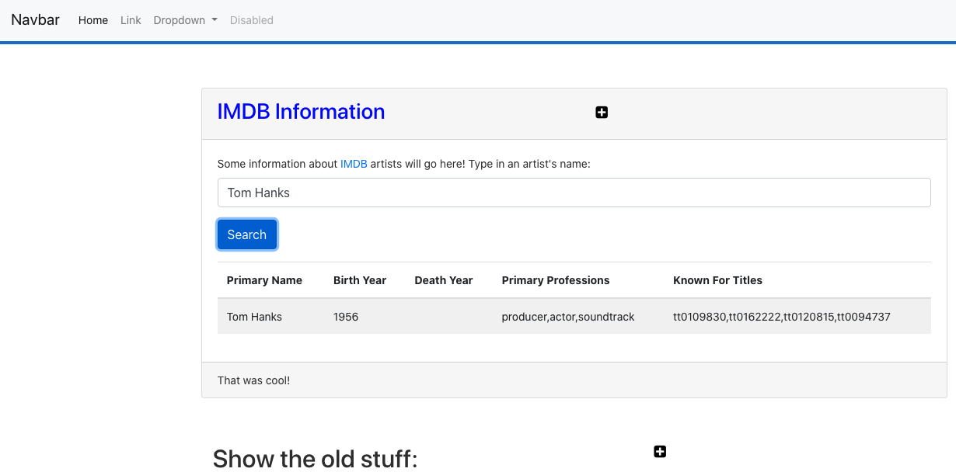
Web Application Architecture
https://dzone.com/articles/architectural-shift-in-web-applications-with-emerg
app.component
navbar.component
imdbartist.component
Template (HTML)
CSS
Component implementation
Service
Show the Code

Slide 4
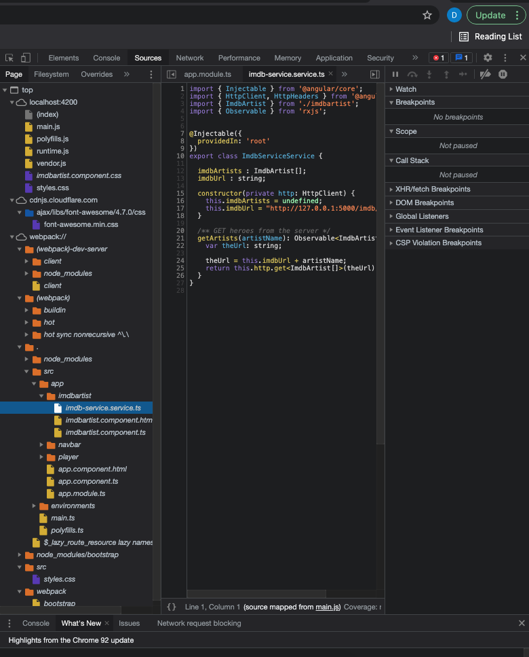
What’s in the Browser
The browser is an application that interprets the files:
HTML, CSS, etc. define the document and content.
JavaScript defines dynamic behavior.
Browser loads index.html
index.html contains links to files.
The browser loads the linked files.
These also have links, which the browser loads.
etc.
How did all of this get in the browser?
A web server delivers these files from “the file system.”
During development, Angular uses a simple, embedded web server.
Deploying the application to the cloud →
We have seen deploying the application logic to the cloud.
What about the content?
Notes:
Show loading the demo-ui.
Show loading cnn.com.

Slide 5
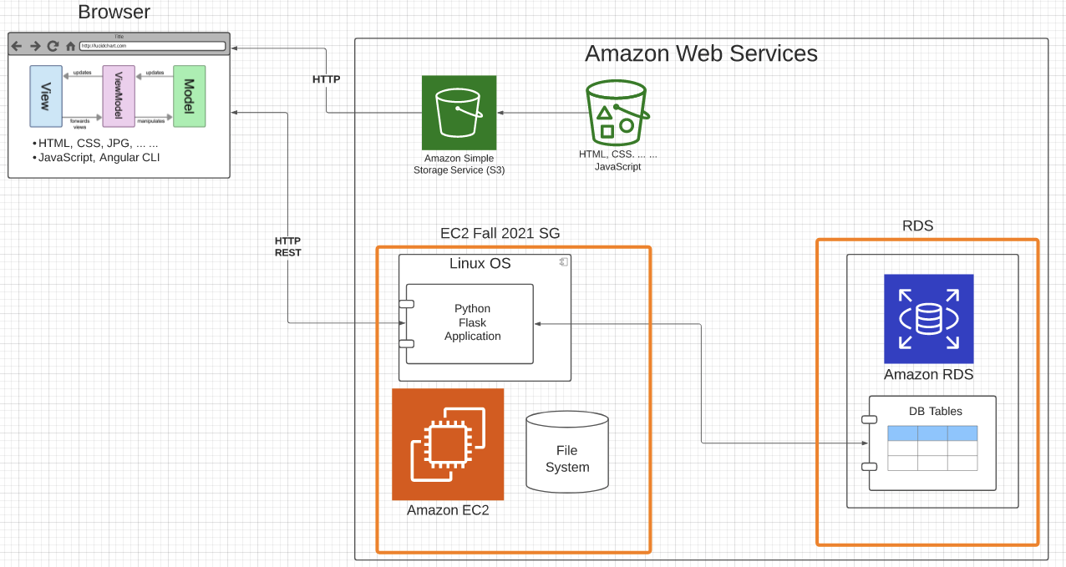
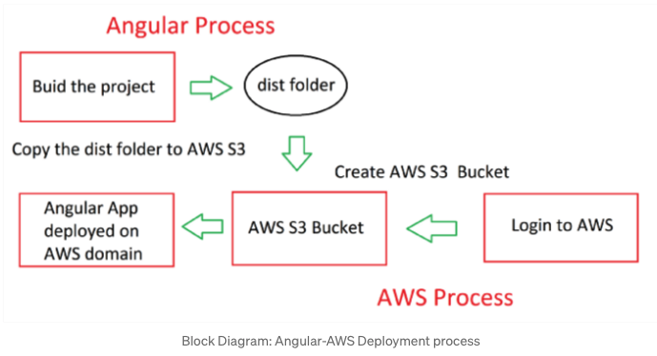
Deploy to S3
https://baljindersingh013.medium.com/angular-app-deployment-with-aws-s3-42d9008734ab
Compile the browser application (ng build -- prod)
You can test with ng serve -- prod
Generates “bundles” that contain:
JavaScript application logic.
HTML, content, ... In the app logic.
Create an S3 bucket.
Upload files from /dist folder.
Enable static web hosting.
Set access permissions.
Set index.html.
We will learn how to automate later.

Slide 6
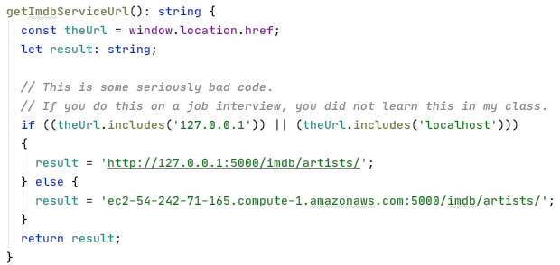
Some Comments
The code is not quite correct: The browser code needs to
Access the local application during dev/test.
The EC2 deployed app during production.
I hacked the code. There are better approaches.
I could have deployed the code on EC2 and delivered from application (Show demo).

Slide 7
Introduction to Microservices
7 | E6156 – Topics in SW Engineering: Cloud Computing: Lecture 1 – Introduction, Course Overview, Concepts © Donald F. Ferguson, 2021

Slide 8
Introduction to REST
8 | E6156 – Topics in SW Engineering: Cloud Computing: Lecture 1 – Introduction, Course Overview, Concepts © Donald F. Ferguson, 2021

Slide 9
Introduction to OAuth 2
9 | E6156 – Topics in SW Engineering: Cloud Computing: Lecture 1 – Introduction, Course Overview, Concepts © Donald F. Ferguson, 2021

Slide 10
Containers/Docker

Slide 11
Google Login
https://developers.google.com/identity/sign-in/web/server-side-flow

Slide 12
We will start in a couple of minutes
12 | E6156 – Topics in SW Engineering: Cloud Computing: Lecture 1 – Introduction, Course Overview, Concepts © Donald F. Ferguson, 2021

Slide 13
Contents and Agenda
13 | E6156 – Topics in SW Engineering: Cloud Computing: Lecture 1 – Introduction, Course Overview, Concepts © Donald F. Ferguson, 2021

Slide 14
Contents and Agenda
Topic | Subtopics | Time
Overview | About your instructor. Syllabus. Logistics. Projects and grading. | 1:10 – 1:30
Core Concepts (I) | IaaS, CaaS, SaaS, PaaS, ... ... IaaS: Some details. Full-stack, web application architecture. Microservices. | 1:30 – 2:15
Break |  | 2:15 – 2:20
Demo, Code walkthrough, ... ... | PyCharm, microservice application code, ... ... WebStorm, Angular CLI, Bootstrap EC2 setup and configuration. GitHub. ... ... | 2:20 – 3:00
Next steps Discussion | Project team formation. Individual project. | 3:00 – ?

Slide 15
Introduction and Overview
15 | E6156 – Topics in SW Engineering: Cloud Computing: Lecture 1 – Introduction, Course Overview, Concepts © Donald F. Ferguson, 2021

